Slide 1
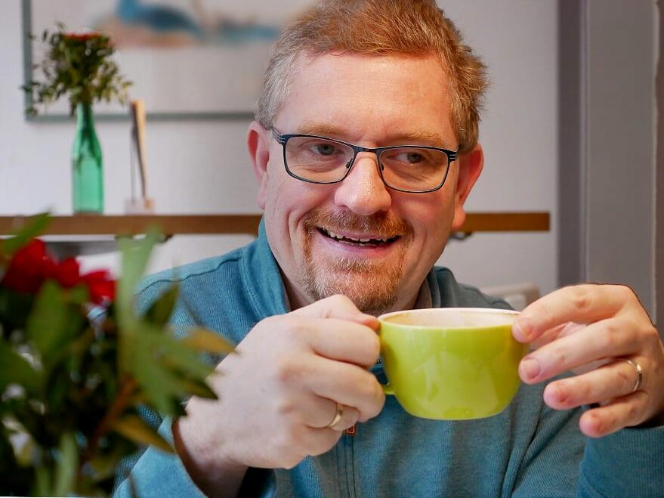
Questions…?
Thoughts 😍

Slide 2

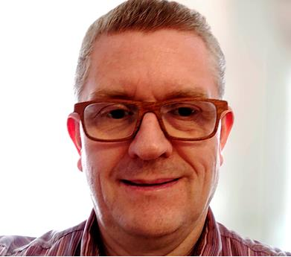






https://thomaskuenneth.eu/
thomas@thomaskuenneth.eu
@tkuenneth
@tkuenneth
@tkuenneth

Slide 3

Thank you Thomas Künneth
https://unsplash.com/photos/M3fhZSBFoFQ

